Slide 1
Reports in myVITA Department Chairs and Deans
Example: Activities-Honors, Awards and Recognition

Slide 2
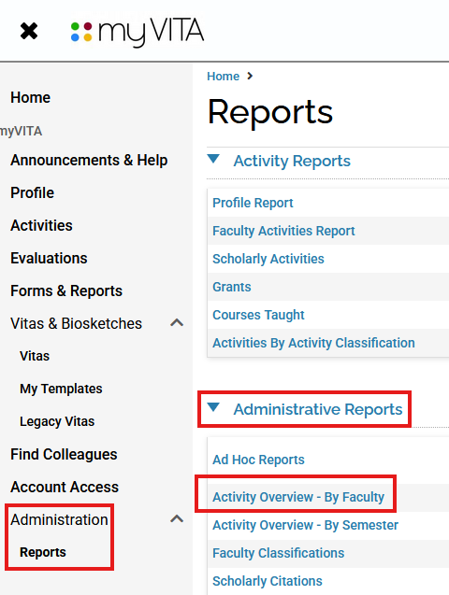
For the example noted in this training (activities, trainings, honors) only information manually entered by faculty will be visible — if it's not entered, it won't appear.
In myVITA click on administration and select reports.
Under Administrative Reports, select Activity Overview-By Faculty.

Slide 3
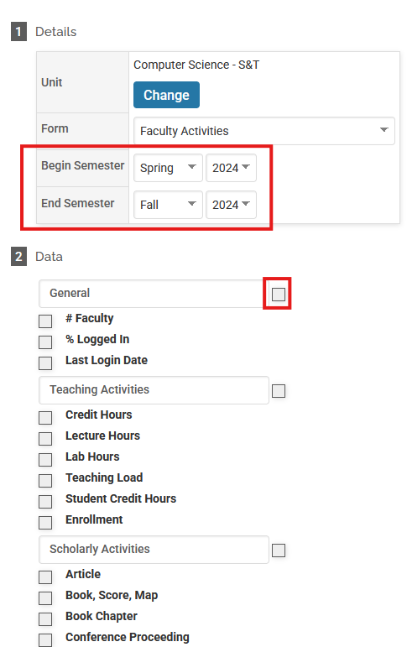
3. In section 1 Details your unit will default to your department or college. Select the dates you want for Begin Semester and End Semester for your report.
4. In Section 2 Data, next to the headers, check the box to unselect all of the details.

Slide 4
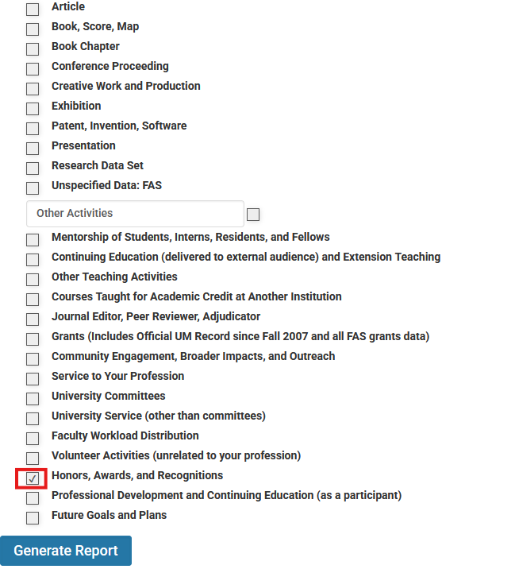

5. In the Other Activities section, you will want the Honors, Awards, and Recognitions box checked.
6. Click generate Report

Slide 5
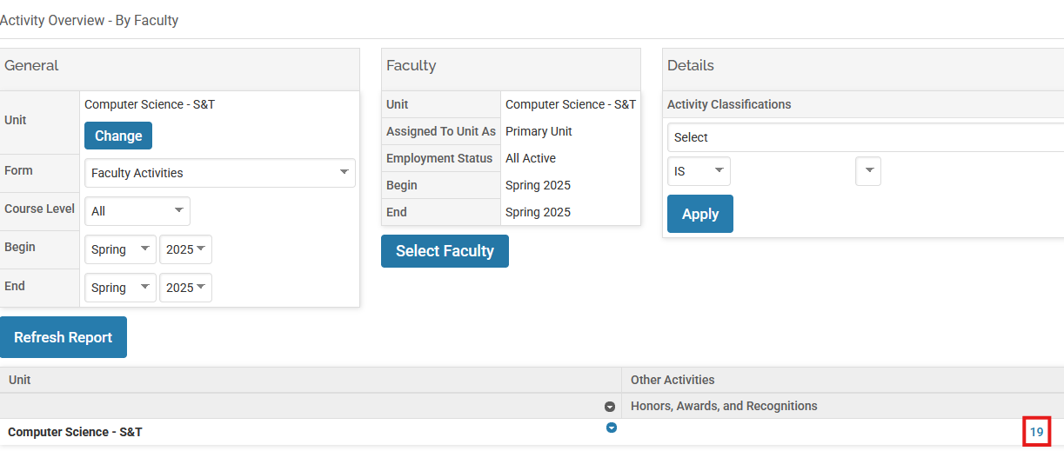
7. From this screen, under Honors, Awards and Recognitions, click on the number listed for your department.

Slide 6
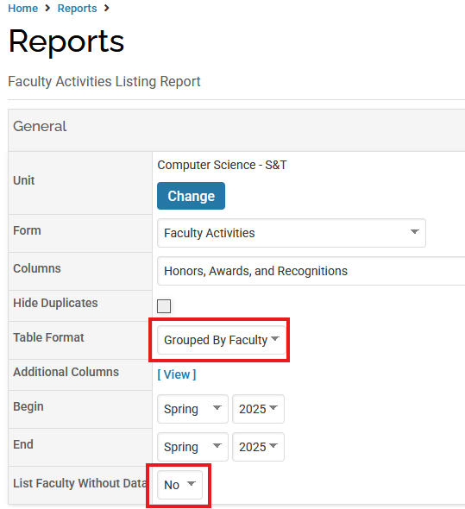
8. For Table Format you can select grouped by faculty or combined. The grouped option is a good option to see everything listed by faculty member.

Slide 7
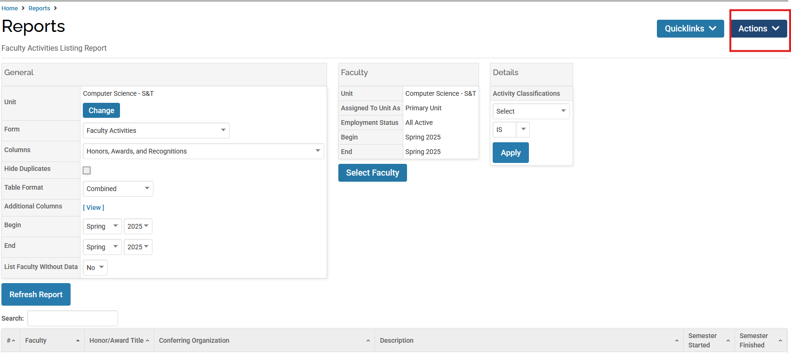
9. Click on Actions and you can export your report.

Slide 8
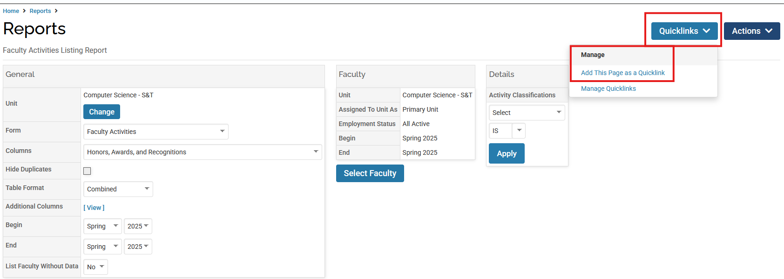
9. Now that you have the report built, you can save the report as a Quicklink to use again. For saved Quicklinks, make sure the dates are correct for future reports.

